Slide 1
Embedded ML Software
Notes:
Embedded ML software
- What is the normal software
- Why that doesn't work on embedded HW
- What does ML software look like on embedded

Slide 2






Caffe
torch
Notes:
TensorFlow, PyTorch, and other training frameworks need resources and dependencies to run, and these don’t exist on embedded systems.
For example, they compile to many megabytes of code, and embedded devices often only have a few hundred kilobytes available.
Our requirements are different too:
Inference-only
No Python needed
Quantization is very important
https://commons.wikimedia.org/wiki/File:Pytorch_logo.png
https://commons.wikimedia.org/wiki/File:Scikit_learn_logo_small.svg
https://commons.wikimedia.org/wiki/File:Theano_logo.svg
https://en.wikipedia.org/wiki/File:Torch_2014_logo.png (FAIR USE ID)

Slide 3
Canned Estimators
Estimators
Keras Model
Datasets
Layers
Python Frontend
C++
Java
Go
...
TensorFlow Distributed Execution Engine
CPU
GPU
OS
XLA (Accelerated LinAlg Compiler)
CPU
GPU
TPU
...

Slide 4


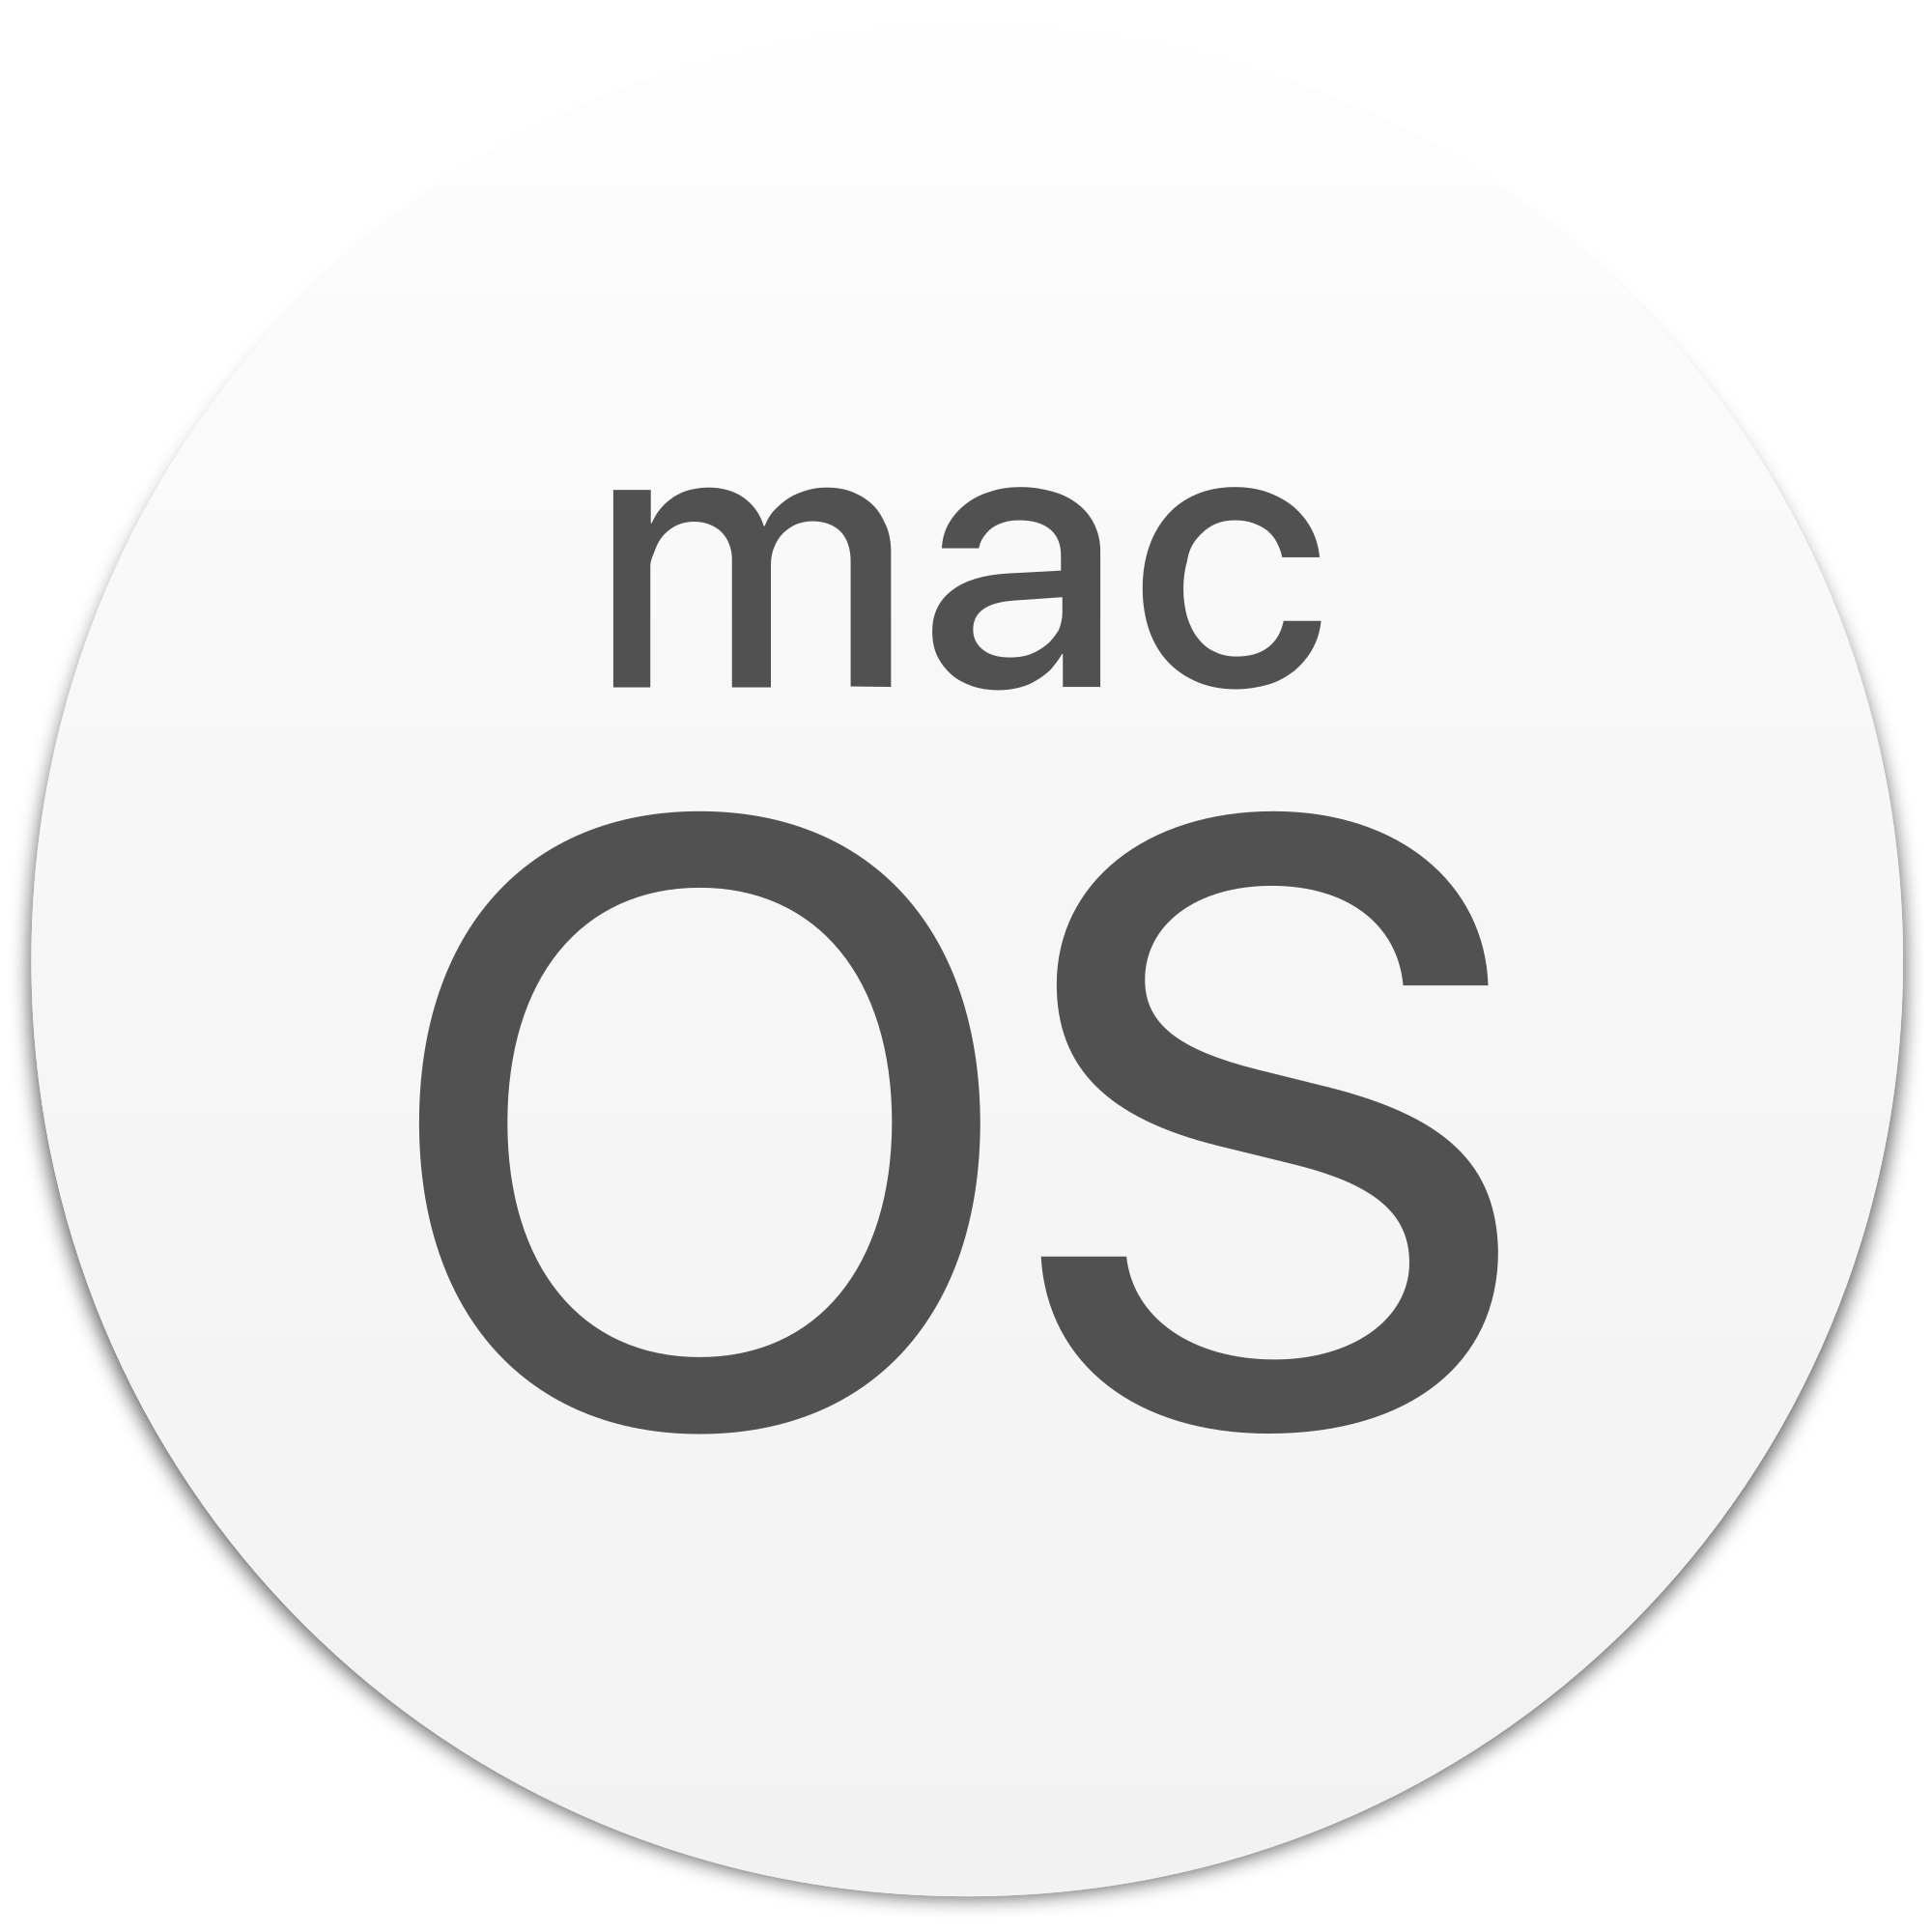

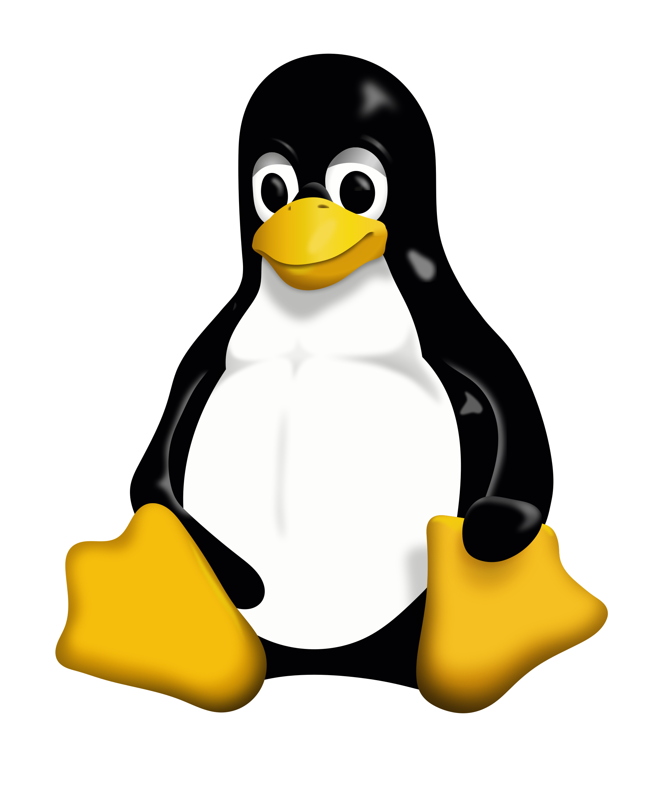
Mobile OS
Linux
Notes:
https://commons.wikimedia.org/wiki/File:Windows_logo_-_2012_derivative.svg (public domain)
https://wiki.videolan.org/File:MacOS_logo.png/ (public domain)
https://commons.wikimedia.org/wiki/File:Tux.svg (permitted use w/ attribution)
https://commons.wikimedia.org/wiki/File:IOS-Emblem.jpg
https://commons.wikimedia.org/wiki/File:Android_robot.svg

Slide 5
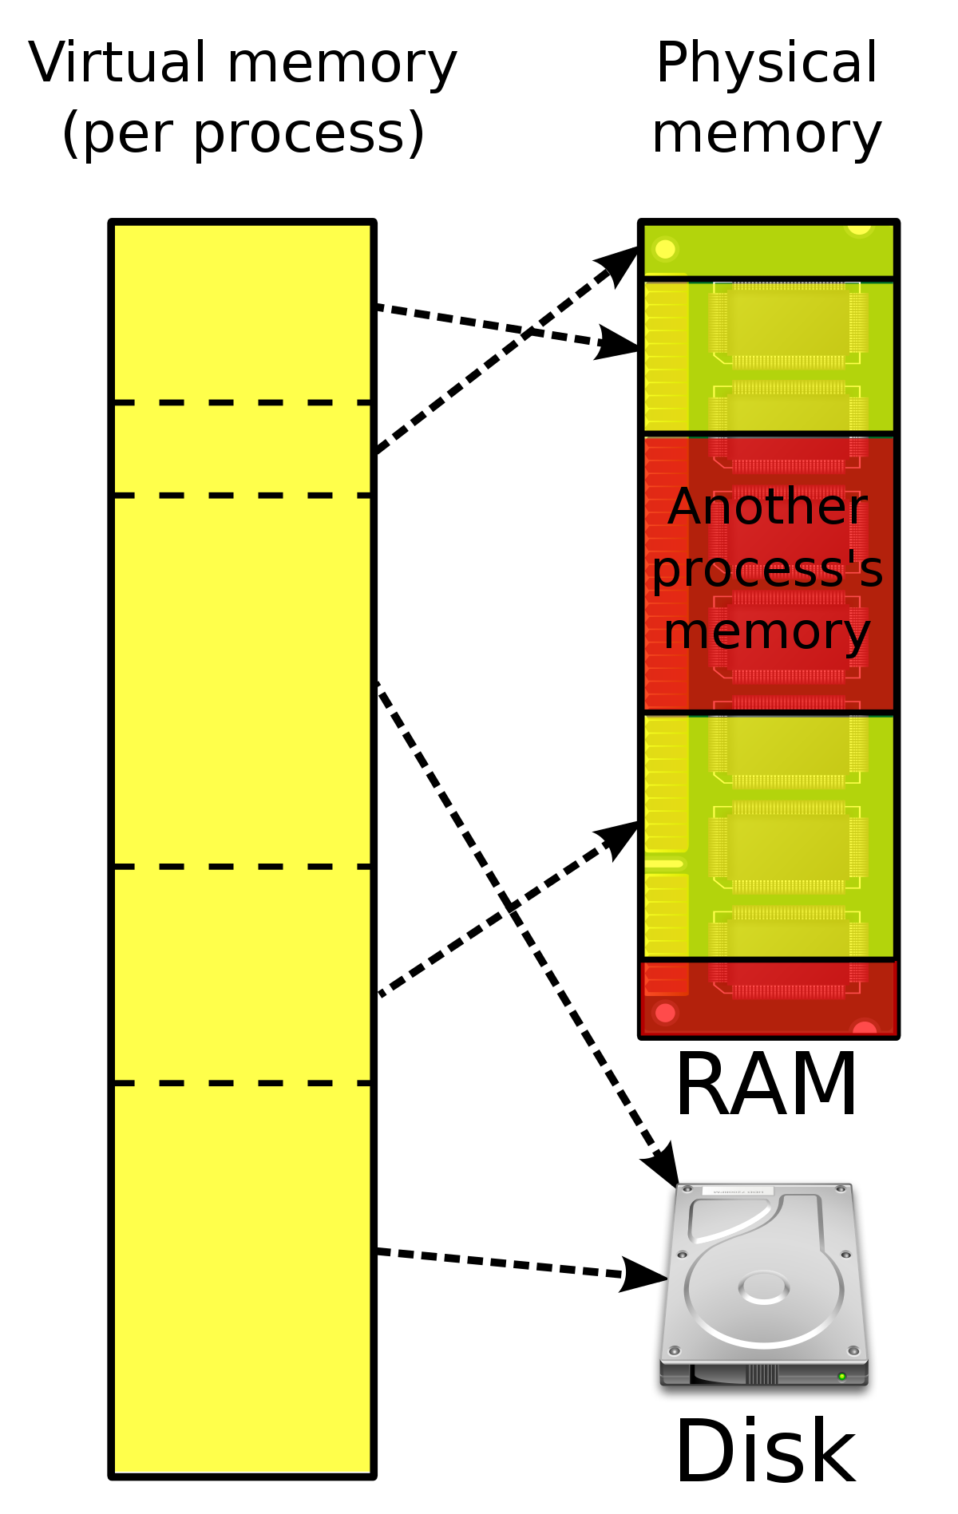
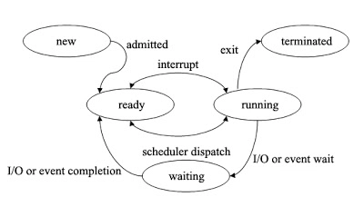
Physical Memory
new
terminated
a
interrupt
a
exit()
b
ready
running
y
x
b
scheduler
wait()
x
waiting
y
process control
Process 1
Virtual Mem
Process 2
Virtual Mem
Notes:
Remind them of stuff about the OS: https://www.cs.uic.edu/~jbell/CourseNotes/OperatingSystems/9_VirtualMemory.html

Slide 6
Physical Memory
new
terminated
a
interrupt
a
exit()
b
ready
running
y
x
b
scheduler
wait()
x
waiting
y
process control
Process 1
Virtual Mem
Process 2
Virtual Mem
Notes:
Remind them of stuff about the OS: https://www.cs.uic.edu/~jbell/CourseNotes/OperatingSystems/9_VirtualMemory.html

Slide 7
Embedded Systems
Arduino
BLE Sense 33
Himax
WE-I Plus EVB
SparkFun
Edge 2
Espressif
EYE

Slide 8
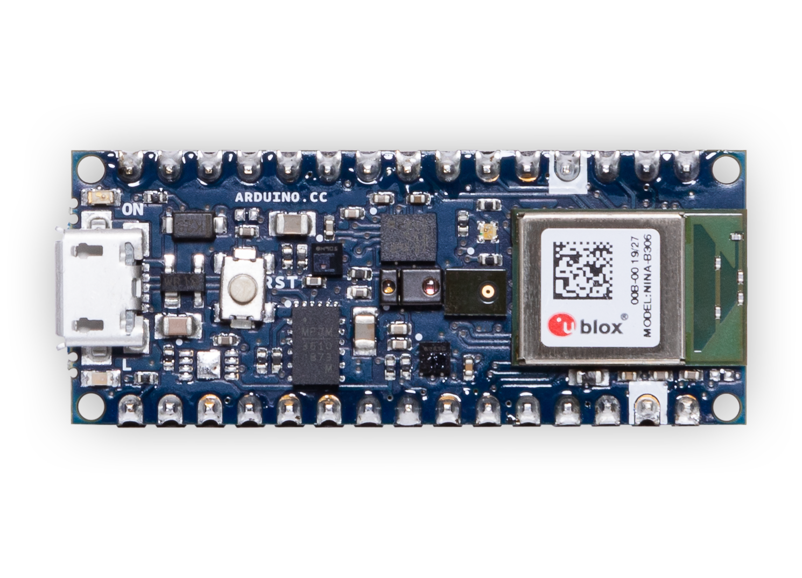
Embedded Systems
Arduino
BLE Sense 33
Himax
WE-I Plus EVB
SparkFun
Edge 2
Espressif
EYE

Slide 9
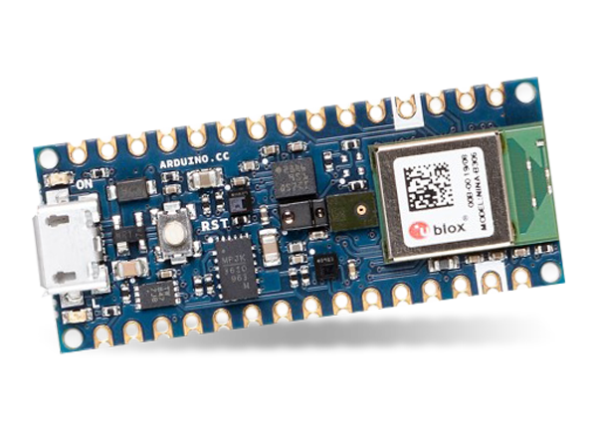
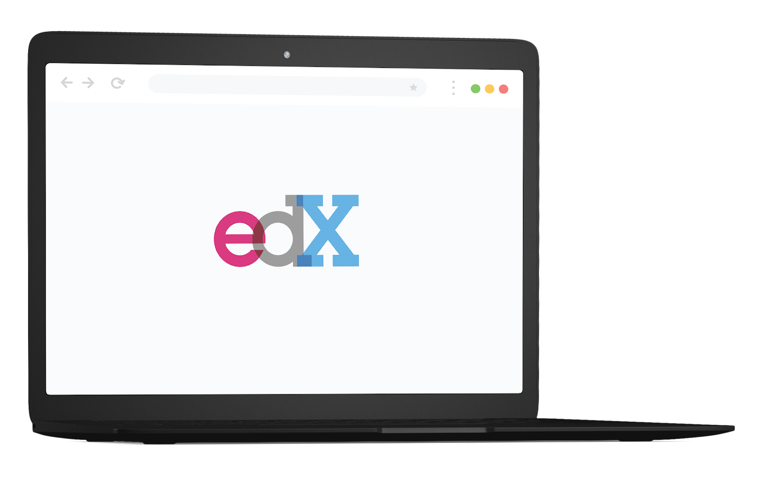
Microprocessor
>
Microcontroller
Platform
Compute
1GHz–4GHz
~10X
1MHz–400MHz
Memory
512MB–64GB
~10000X
2KB–512KB
Storage
64GB–4TB
~100000X
32KB–2MB
Power
30W–300W
~1000X
150μW–23.5mW
 | Microprocessor | Microcontroller
Platform | Laptop | Arduino
Compute | 1 GHz to 4 GHz | 1 MHz to 400 MHz
Memory | 512 MB to 64 GB | 2 KB to 512 KB
Storage | 64 GB to 4 TB | 32 KB to 2 MB

Slide 10
Microprocessor
>
Microcontroller
Platform
Compute
1GHz–4GHz
~10X
1MHz–400MHz
Memory
512MB–64GB
~10000X
2KB–512KB
Storage
64GB–4TB
~100000X
32KB–2MB
Power
30W–300W
~1000X
150μW–23.5mW
 | Microprocessor | Microcontroller
Platform | Laptop | Arduino
Compute | 1 GHz to 4 GHz | 1 MHz to 400 MHz
Memory | 512 MB to 64 GB | 2 KB to 512 KB
Storage | 64 GB to 4 TB | 32 KB to 2 MB

Slide 11
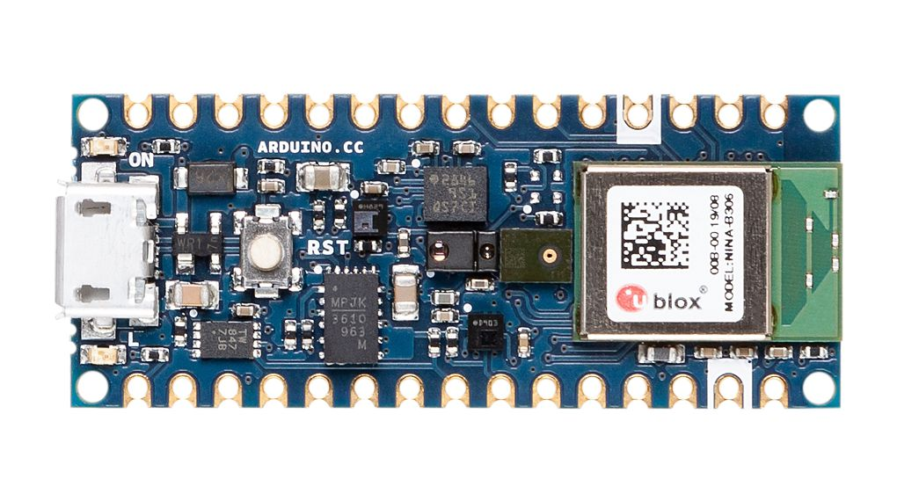
Less memory
Limited OS support
Lower compute power
Only focused on inference
?

Slide 12
TinyML Inference Framework
Model
Software
Hardware

Slide 13
ML Framework
Design Checklist
Model
Support for training?
Yes
No
Support for inference?
Yes
No
How many ops?
few
Notes:
I would say as of today (whenever you record it), this is what the high-level differences are. For example
*How many ops --> 50 (but that could be because of eng resources)
*Delegation to accelerators --> Its no because microcontroller don't have accelerators yet. If we have microNPU, I don't see why the accelerator driver code can't be integrated within TFLite Micro.

Slide 14
ML Framework
Design Checklist
Software
Need quantization/optimization tools?
Yes
No
Yes
Can rely on virtual memory support?
Yes
No
Model
Support for training?
Yes
No
Support for inference?
Yes
No
How many ops?
few
Notes:
I would say as of today (whenever you record it), this is what the high-level differences are. For example
*How many ops --> 50 (but that could be because of eng resources)
*Delegation to accelerators --> Its no because microcontroller don't have accelerators yet. If we have microNPU, I don't see why the accelerator driver code can't be integrated within TFLite Micro.

Slide 15
ML Framework
Design Checklist
Software
Need quantization/optimization tools?
Yes
No
Yes
Can rely on virtual memory support?
Yes
No
Model
Hardware
Support for training?
Yes
No
Support for inference?
Yes
No
Yes
No
Support a diverse range of processor hardware on a device?
How many ops?
Yes
No
few
Need to support many different platforms and architectures?
Yes
Notes:
I would say as of today (whenever you record it), this is what the high-level differences are. For example
*How many ops --> 50 (but that could be because of eng resources)
*Delegation to accelerators --> Its no because microcontroller don't have accelerators yet. If we have microNPU, I don't see why the accelerator driver code can't be integrated within TFLite Micro.

Slide 16


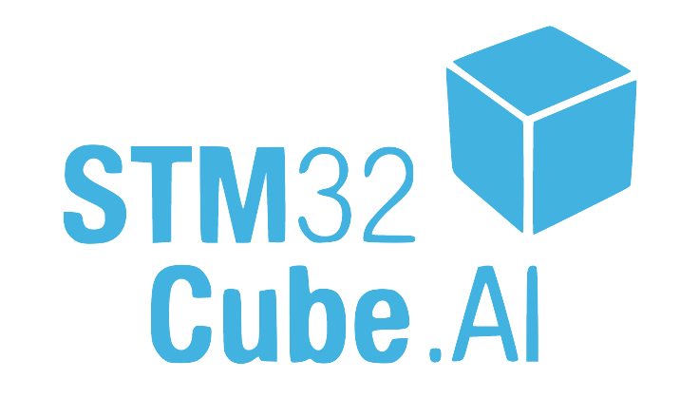
“Tiny” Machine Learning Frameworks
Arduino
BLE Sense 33
Micro
Himax
WE-I Plus EVB
Hardware vendor libraries (ST’s CubeMX.AI)
uTensor
SparkFun
Edge 2
Espressif
EYE
Notes:
All optimized for embedded devices’ resource constraints (memory, compute)
All import models from a separate training framework
All use C or C++ code.
https://github.com/apache/tvm (TVM logo Apache 2 license)
https://github.com/pytorch/glow (Glow logo Apache 2)
Hand-drew STM logo, but it’s based on theirs. (https://www.st.com/content/st_com/en/products/development-tools/software-development-tools/stm32-software-development-tools/stm32-configurators-and-code-generators/stm32cubemx.html)

Slide 17
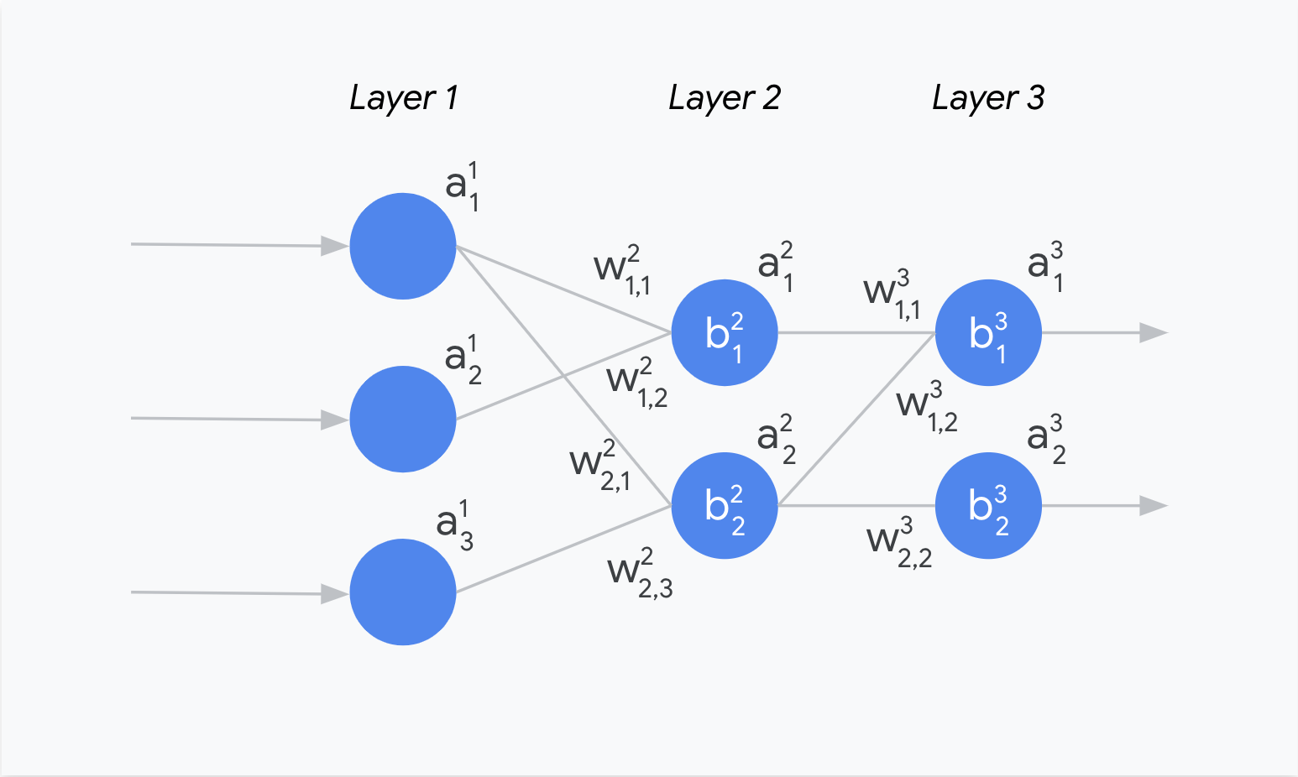
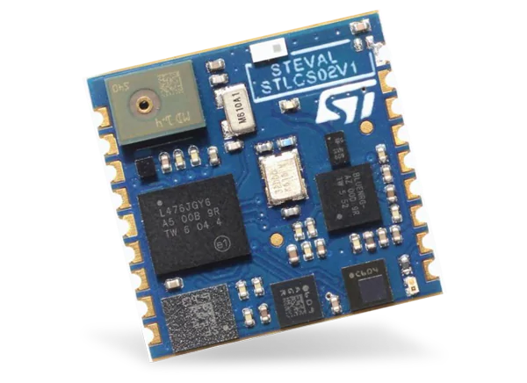
pre-trained NN model
topology, weights, bias
STM32L476 Cortex-M4 MCU
Notes:
All optimized for embedded devices’ resource constraints (memory, compute)
All import models from a separate training framework
All use C or C++ code.
https://www.mouser.com/new/stmicroelectronics/stm-sensortile-sensor-nodes/

Slide 18
pre-trained NN model
topology, weights, bias
command line interface
STM32L476 Cortex-M4 MCU
Notes:
All optimized for embedded devices’ resource constraints (memory, compute)
All import models from a separate training framework
All use C or C++ code.
https://www.mouser.com/new/stmicroelectronics/stm-sensortile-sensor-nodes/

Slide 19
parameters:
(1) name, (2) compression factor, (3) targeted STM32
pre-trained NN model
topology, weights, bias
upload
Generate
command line interface
STM32L476 Cortex-M4 MCU
Notes:
All optimized for embedded devices’ resource constraints (memory, compute)
All import models from a separate training framework
All use C or C++ code.
https://www.mouser.com/new/stmicroelectronics/stm-sensortile-sensor-nodes/

Slide 20
parameters:
(1) name, (2) compression factor, (3) targeted STM32
pre-trained NN model
topology, weights, bias
upload
Importer
PINNR
Generate
command line interface
STM32L476 Cortex-M4 MCU
Notes:
All optimized for embedded devices’ resource constraints (memory, compute)
All import models from a separate training framework
All use C or C++ code.
https://www.mouser.com/new/stmicroelectronics/stm-sensortile-sensor-nodes/

Slide 21
parameters:
(1) name, (2) compression factor, (3) targeted STM32
pre-trained NN model
topology, weights, bias
upload
Importer
PINNR
C-code generator (optimizer)
Generate
command line interface
STM32L476 Cortex-M4 MCU
Notes:
All optimized for embedded devices’ resource constraints (memory, compute)
All import models from a separate training framework
All use C or C++ code.
https://www.mouser.com/new/stmicroelectronics/stm-sensortile-sensor-nodes/

Slide 22
parameters:
(1) name, (2) compression factor, (3) targeted STM32
pre-trained NN model
topology, weights, bias
upload
Importer
PINNR
C-code generator (optimizer)
Generate
target-dependent optimized kernel runtime libraries
command line interface
STM32L476 Cortex-M4 MCU
Notes:
All optimized for embedded devices’ resource constraints (memory, compute)
All import models from a separate training framework
All use C or C++ code.
https://www.mouser.com/new/stmicroelectronics/stm-sensortile-sensor-nodes/

Slide 23
parameters:
(1) name, (2) compression factor, (3) targeted STM32
pre-trained NN model
topology, weights, bias
.c
.h
upload
Importer
PINNR
C-code generator (optimizer)
Generate
.a
target-dependent optimized kernel runtime libraries
command line interface
STM32L476 Cortex-M4 MCU
Notes:
All optimized for embedded devices’ resource constraints (memory, compute)
All import models from a separate training framework
All use C or C++ code.
https://www.mouser.com/new/stmicroelectronics/stm-sensortile-sensor-nodes/

Slide 24
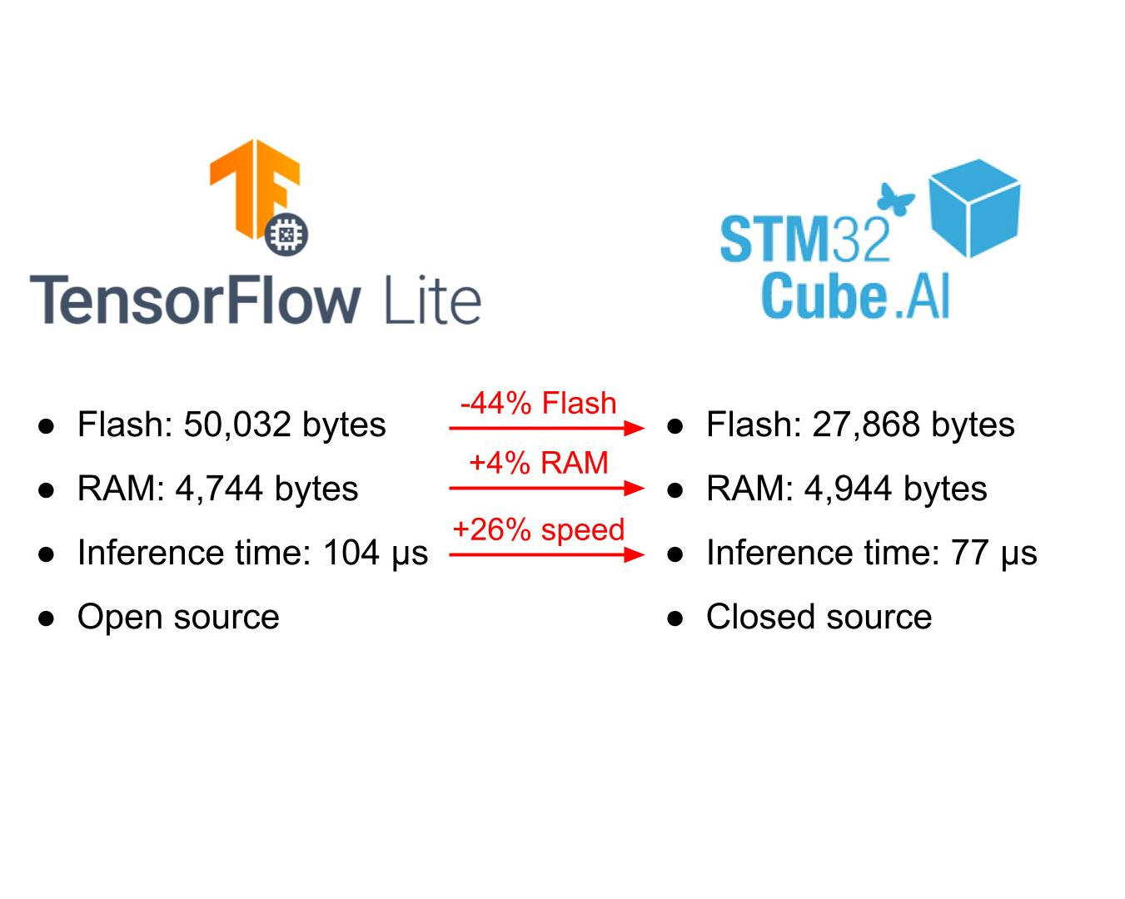
Model
27kB Flash
5kB RAM
77uS Inference Time
Closed Source
50kB Flash
4.7kB RAM
104uS Inference Time
Open Source
3 dense layers
321 parameters
No quantization or compression
Notes:
Some generate code to run a model, others use a data-driven approach with an interpreter.
They rely on different training frameworks and interchange formats to load models.
Most are only optimized for particular platforms.
Their memory, binary size, and resource requirements vary a lot.

Slide 25
Model
27kB Flash
5kB RAM
77uS Inference Time
Closed Source
50kB Flash
4.7kB RAM
104uS Inference Time
Open Source
3 dense layers
321 parameters
No quantization or compression
Notes:
Some generate code to run a model, others use a data-driven approach with an interpreter.
They rely on different training frameworks and interchange formats to load models.
Most are only optimized for particular platforms.
Their memory, binary size, and resource requirements vary a lot.

Slide 26
Model
27kB Flash
5kB RAM
77uS Inference Time
Closed Source
50kB Flash
4.7kB RAM
104uS Inference Time
Open Source
3 dense layers
321 parameters
No quantization or compression
Notes:
Some generate code to run a model, others use a data-driven approach with an interpreter.
They rely on different training frameworks and interchange formats to load models.
Most are only optimized for particular platforms.
Their memory, binary size, and resource requirements vary a lot.

Slide 27
Choosing Frameworks
Hardware, IDE
Training/Embedded
other
compute
memory constraints
training framework
embedded framework (you’ll export to)
documentation
sample code (for use case)
personal experience

Slide 28
Choosing Frameworks
Collect
Data
Preprocess
Data
Design a
Model
Train a
Model
Evaluate
Optimize
Convert
Model
Deploy
Model
Make
Inferences
Micro

Slide 29
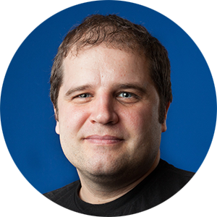
Choosing Frameworks
Collect
Data
Preprocess
Data
Design a
Model
Train a
Model
Evaluate
Optimize
Convert
Model
Deploy
Model
Make
Inferences
Micro
Pete Warden, Technical Lead, TensorFlow Mobile and Embedded Team, Google.

